Slide 1
What Comics and Graphic Novels Can Teach Us About History and Critical Thinking Skills
Or,
“Teach your students to read graphic histories as secondary sources”
Trevor R. Getz

Slide 2
Graphic History (n): Integrated, sequential art and text used to produce an intentional interpretation of the past.

Slide 3
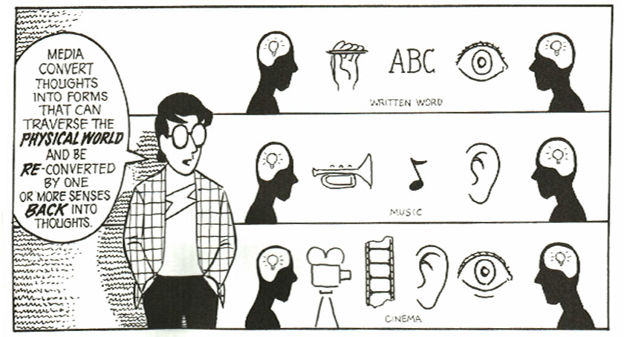

Slide 4
Notes:
Lots of reasons translation is tricky

Slide 5
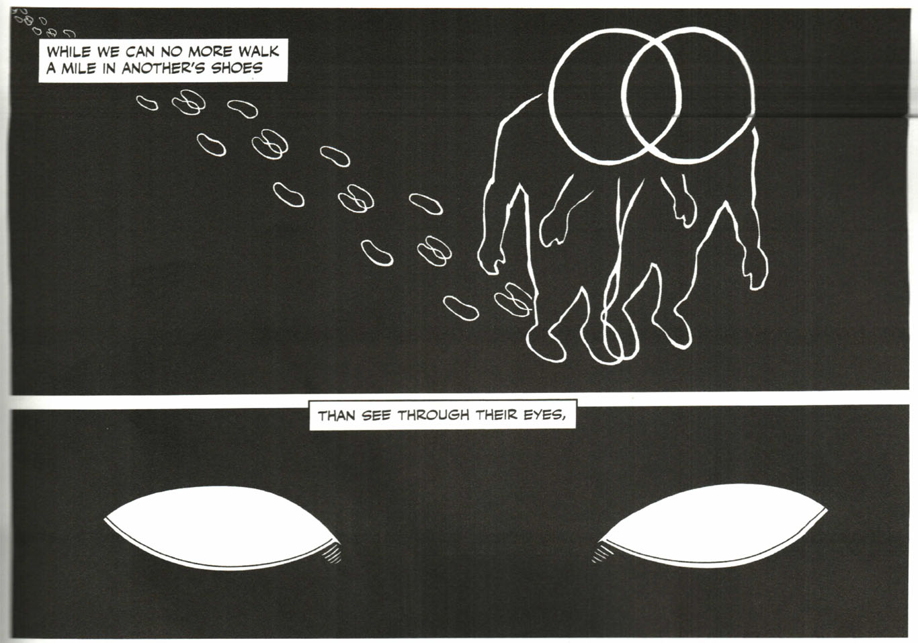

Slide 6
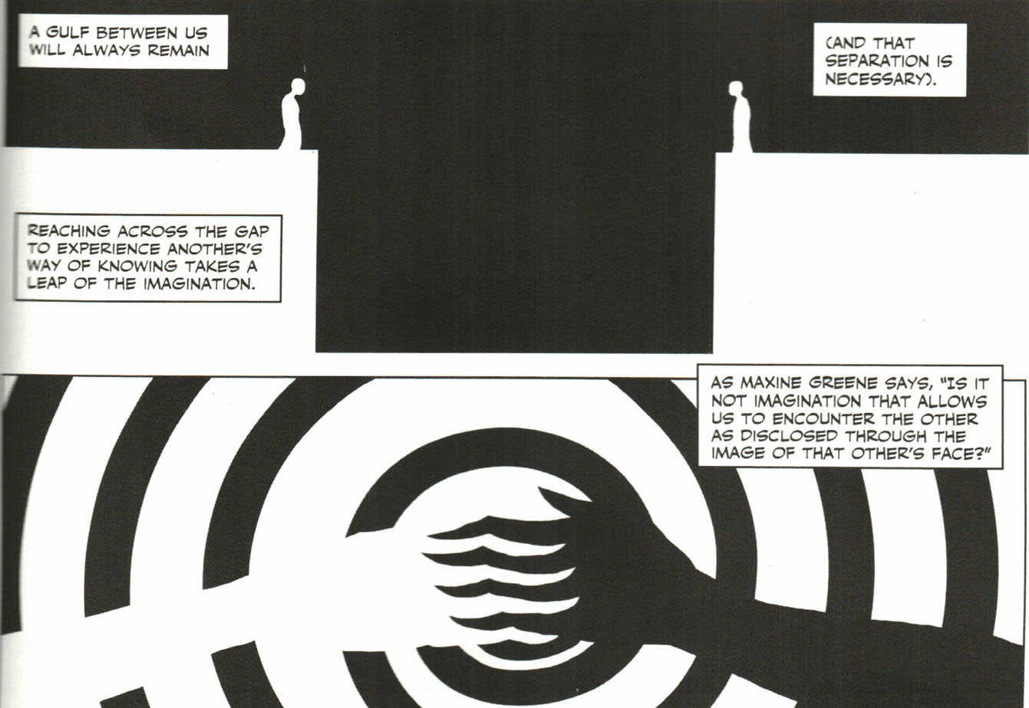

Slide 7
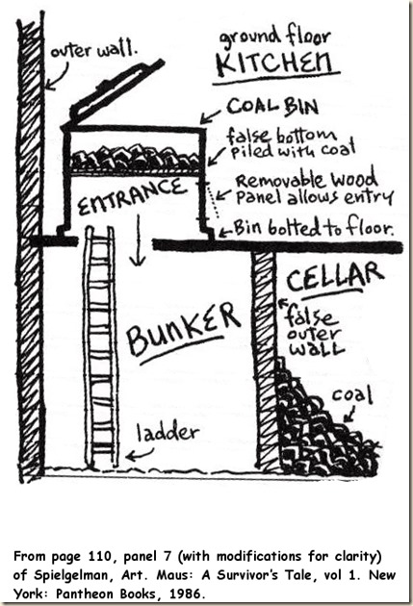

Slide 9
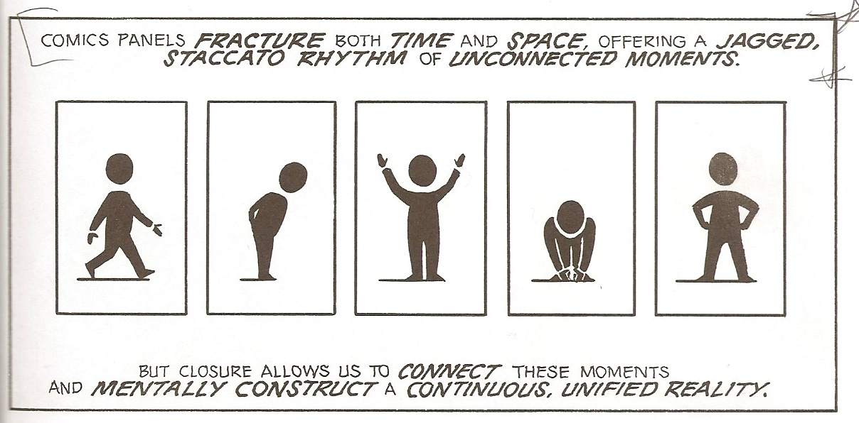

Slide 10
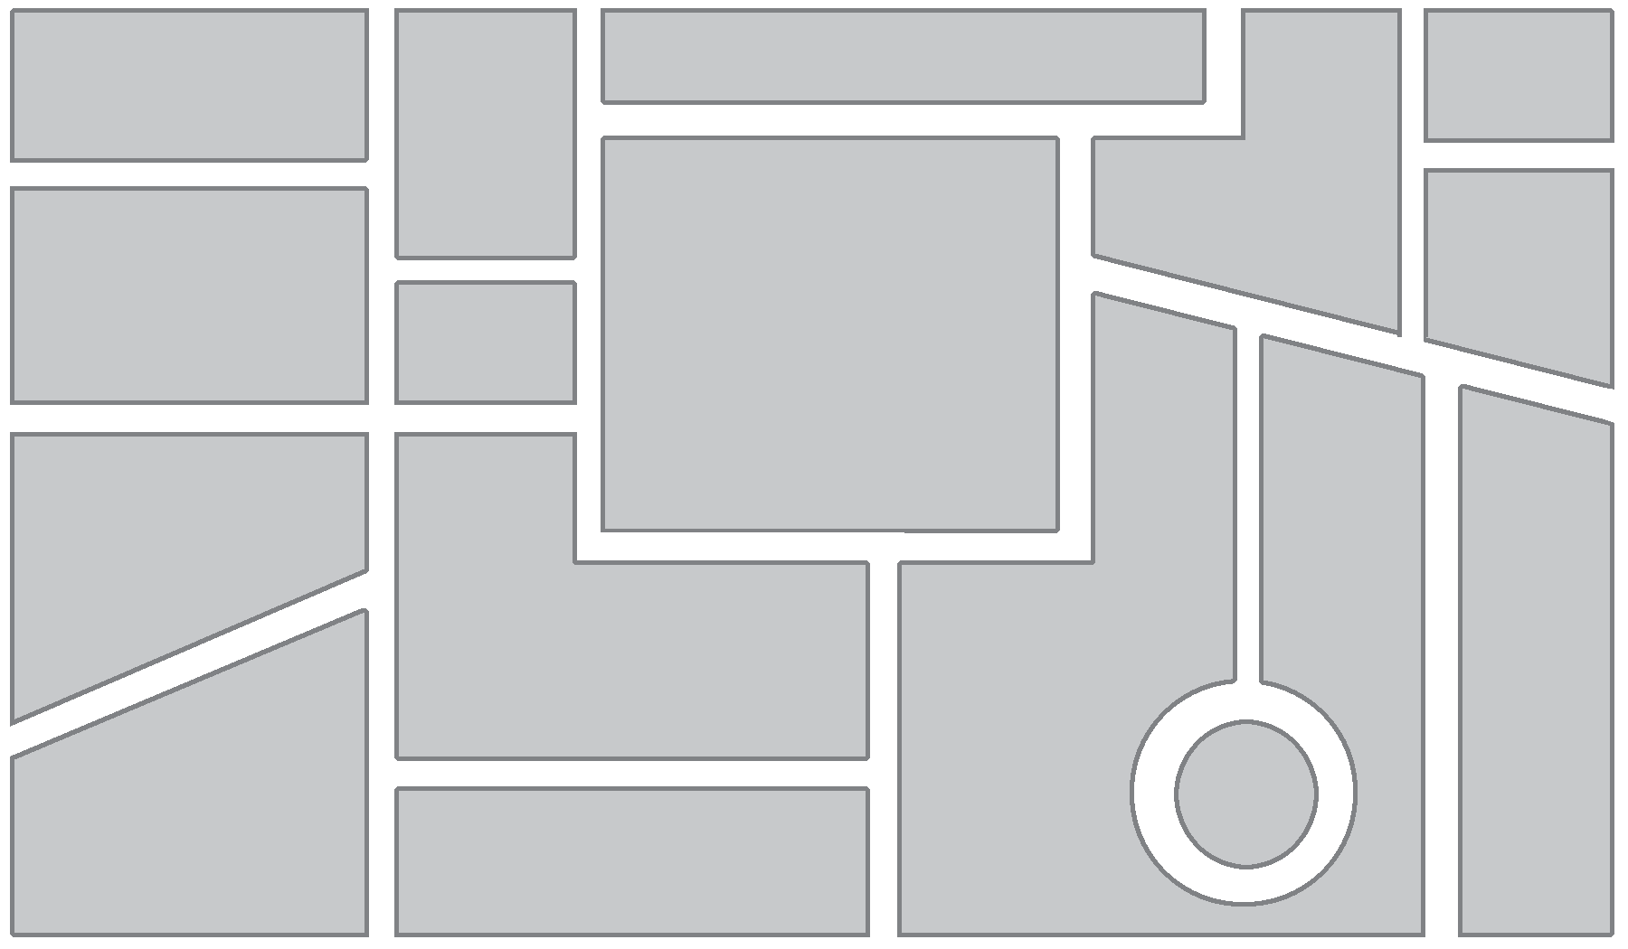
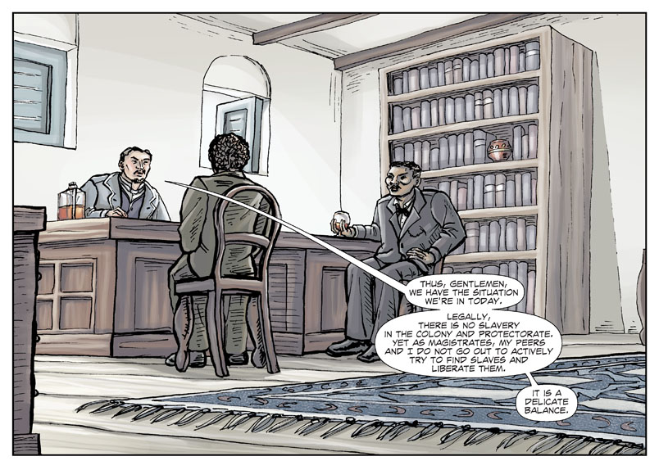
A panel is a visual or implied boundary that contains a piece of the story.

Slide 11
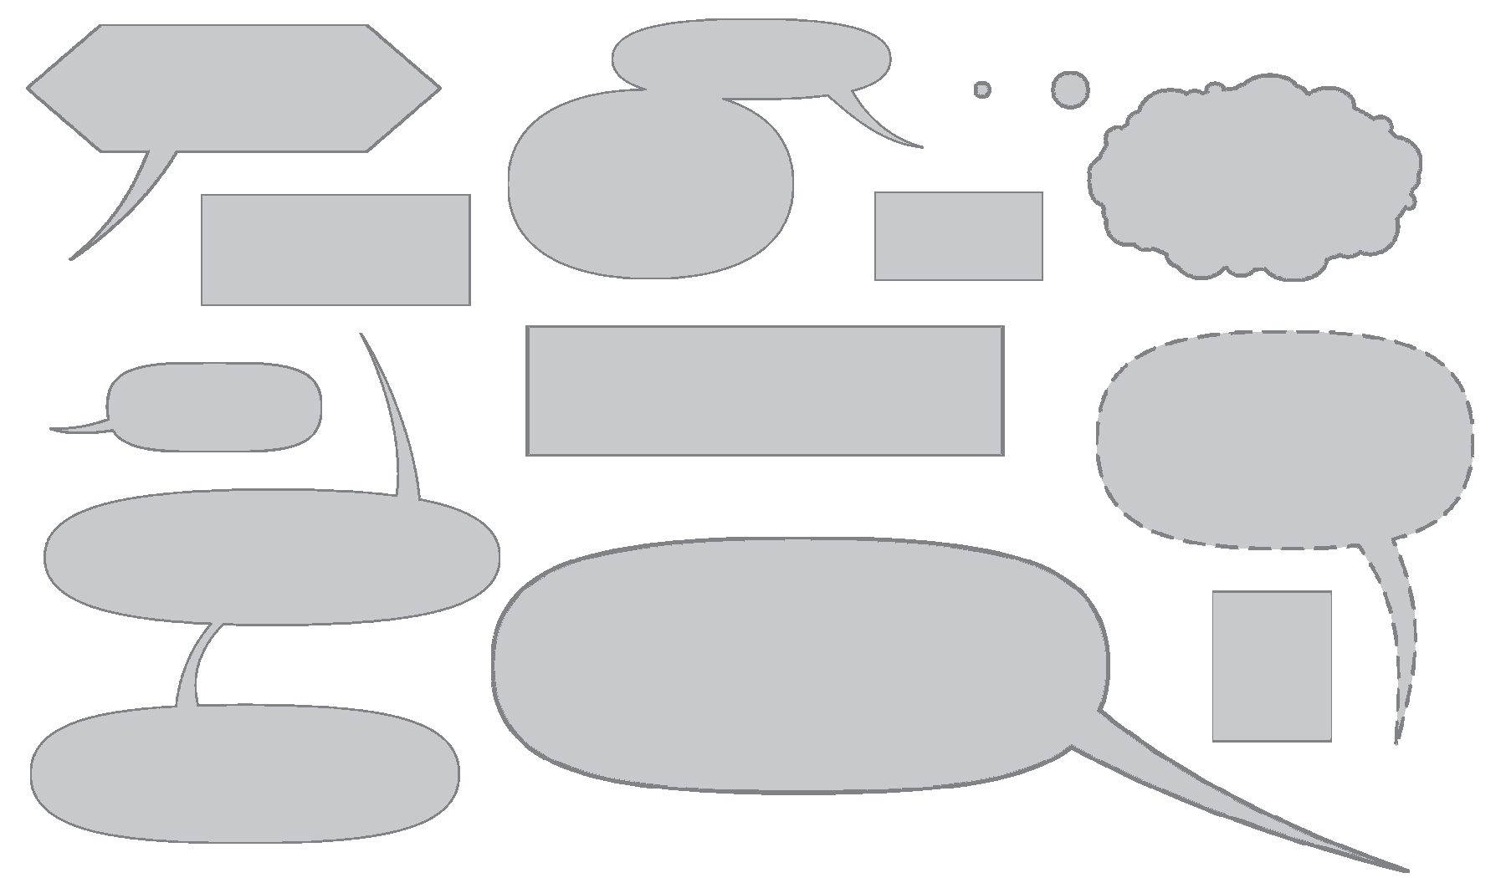
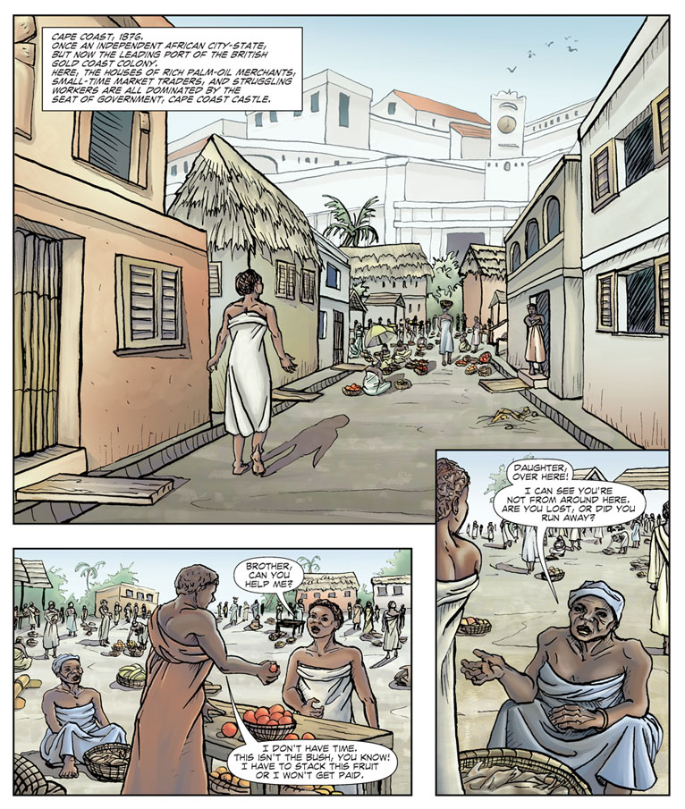
Usually found inside a panel, balloons are the visual spaces where the print-text in the story appears.

Slide 12
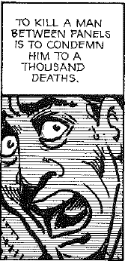
Notes:
Gutter forces reader to actively participate in the source. Have to fill in the gaps

Slide 13
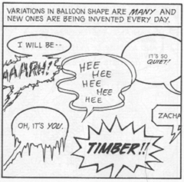

Slide 14
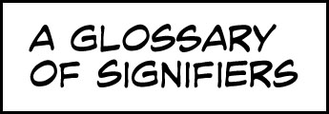
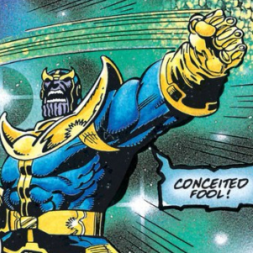
Agitrons: wiggly lines around a shaking object or character
Blurgits: curved lines preceding or trailing after a character's moving limbs
Briffits: clouds of dust that hang in the wake of a swiftly departing character or object
Dites: diagonal, straight lines drawn across flat, clear and reflective surfaces, such as windows and mirrors
Emanata: lines drawn around the head to indicate shock or surprise
Hites: horizontal straight lines trailing after something moving with great speed; or, drawn on something indicating reflectivity (puddle, glass, mirror)
Indotherm: wavy, rising lines used to represent steam or heat; when the same shape is used to denote smell, it is called a wafteron

Slide 15
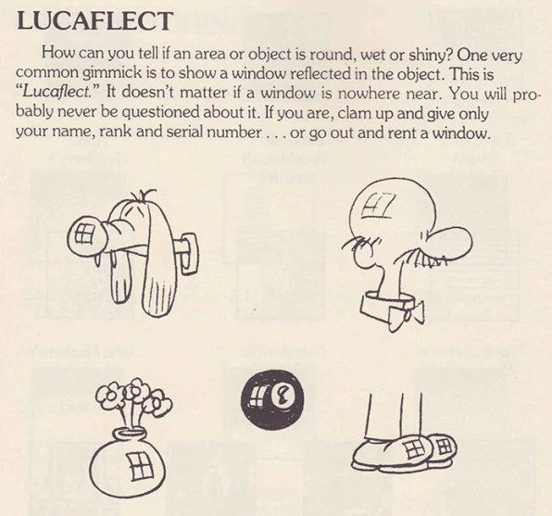
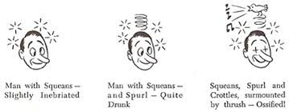
Plewds: flying sweat droplets that appear around a character's head when working hard, stressed, etc.
Quimps: planets resembling Saturn, used to replace obscenities
Solrads: radiating lines drawn from something luminous like a lightbulb or the sun
Squeans: little starbursts or circles that signify intoxification, dizziness, or sickness. Also see Spurl (springs) and Crottles (crosses for eyes)
Grawlixes: typographical symbols standing in for profanities, appearing in dialogue balloons in place of actual dialogue
Lucaflect: a shiny spot on a surface of something, depicted as a four-paned window shape
Vites: vertical straight lines indicating reflectivity (compare dites, hites)
From Mort Walker’s The Lexicon of Comicana

Slide 16
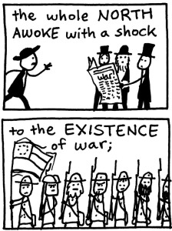
Abstract to realistic
Historical accuracy ~ I don't have any photos / portraits / images of Freeman Colby (& most other non-famous characters in the story), so I don't want to add any details that aren't based in the historical record. Thus two dots & a line, the blank mask of anonymity.
Readers' access ~ More iconic characters are closer to readers' sense of themselves
Drawing speed / reading speed ~ There's a temptation (at least for me) to fill in as many details as possible in an image/story. Abstraction & focus on minimal essential details helps my panels & pages breathe, helps me (& my readers) move through the IDEAS of the story without getting bogged down in non-essential details.
Sleep deprivation ~ I drew my first "Stick Figure Civil War" stories at the tail end of my 3rd 24 hour comic, when after drawing for 18 hours straight, I turned out of desperation to stick figures & was impressed by how fun & expressive they could be in a historical setting. That approach, with modifications, leads to Freeman Colby.
Marek Bennett, The Civil War Diary of Freeman Colby

Slide 17
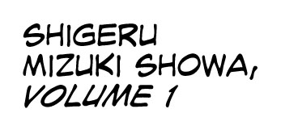

Slide 18
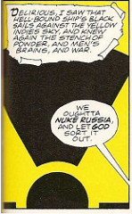
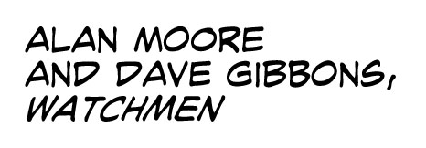

Slide 19
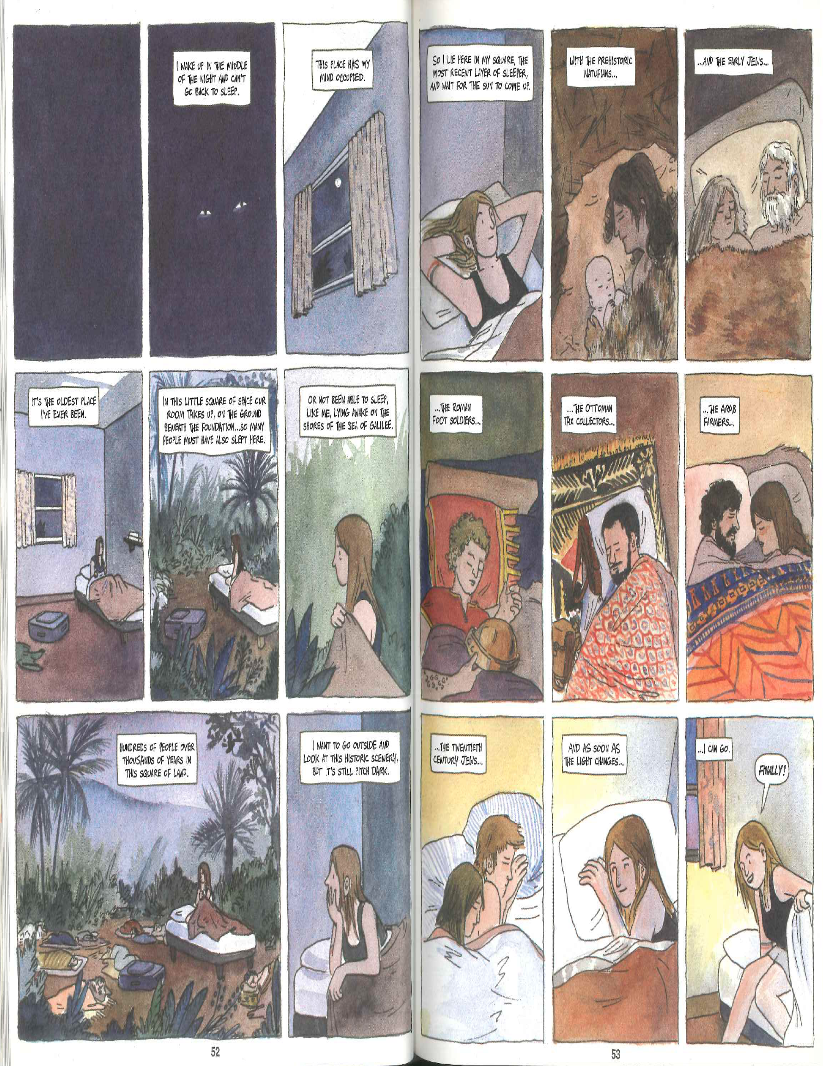
Notes:
In comics, due to the layout of the page, images are both sequential (1, 2, 3, 4) and simultaneous at the same time (1, 4). This allows for especially rich discussion in the history classroom. Can see both cause and effect and long term change over time on same page.

Slide 20
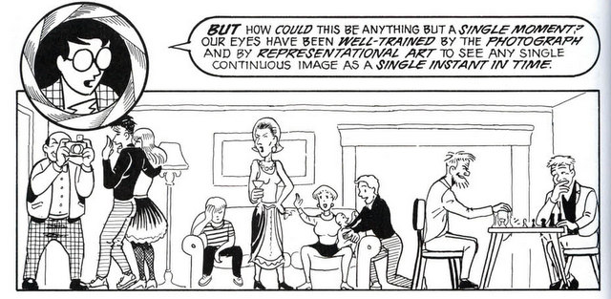

Slide 21
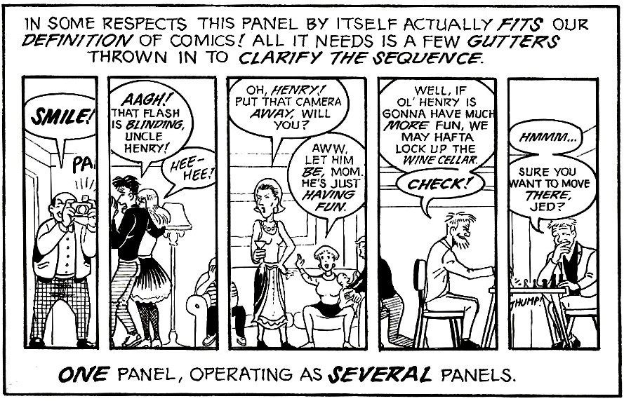

Slide 22
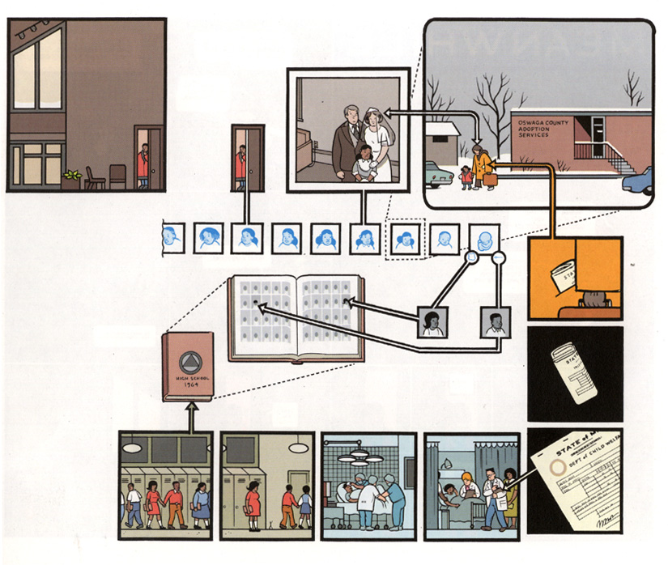
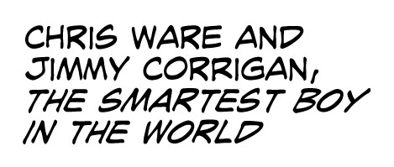

Slide 23
