Slide 1
Avoiding Budget Catastrophe
Len Burman
Syracuse University and NBER
Central New York Council for the Social Studies
October 4, 2011

Slide 2
Deficit Projections for Obama Budget, in $billions

Slide 4
Major Foreign Holders of US Debt, in $billions, December 2010

Slide 5
Distribution of Debt Crises by Debt Level, Middle-Income Countries, 1970-2008
Maximum external debt/GNP at time of crisis | Cumulative % of total debt crises
40 | 19
60 | 52
80 | 68
100 | 84
> 100 | 100
Source: Reinhart and Rogoff (2009), p. 24.

Slide 6
The Longer we Delay, the More Painful the Adjustment: Required Tax Increase or Spending Cut to Stabilize the Debt
Year Action is Taken | Raise Tax Rates |  | Cut Benefits
 | % of GDP | % of Revenues | % of GDP | % of Spending
2015 | 2 | 11 | 2 ½ | 12 ½
2025 | 5 ½ | 26 ½ | 6 | 26
Effect on GDP (2050) | - 7 |  | - 2 ½
Source: CBO, “Economic Impacts of Waiting to Resolve the Long-term Budget Imbalance,” Economic and Budget Issue Brief, December 2010.

Slide 11
Major Foreign Holders of US Debt, in $billions, December 2010

Slide 12
Distribution of Debt Crises by Debt Level, Middle-Income Countries, 1970-2008
Maximum external debt/GNP at time of crisis | Cumulative % of total debt crises
40 | 19
60 | 52
80 | 68
100 | 84
> 100 | 100
Source: Reinhart and Rogoff (2009), p. 24.

Slide 13
Current Policy with Risk Premium
Current Policy
BPC Plan

Slide 14
Interest Plus Debt Service

Slide 15
The Longer we Delay, the More Painful the Adjustment: Required Tax Increase or Spending Cut to Stabilize the Debt
Year Action is Taken | Raise Tax Rates |  | Cut Benefits
 | % of GDP | % of Revenues | % of GDP | % of Spending
2015 | 2 | 11 | 2 ½ | 12 ½
2025 | 5 ½ | 26 ½ | 6 | 26
Effect on GDP (2050) | - 7 |  | - 2 ½
Source: CBO, “Economic Impacts of Waiting to Resolve the Long-term Budget Imbalance,” Economic and Budget Issue Brief, December 2010.

Slide 16
But Can we Act too Soon?
Source: CBO

Slide 19
How would you deal with the debt?
Cut foreign aid?
Tax corporate jets?
Eliminate waste fraud and abuse?
Eliminate earmarks?
Raise tax rates on rich people?

Slide 20
The Solution!!!
Talk about how urgent the problem is, threaten to default on our obligations, almost shut down the government, and then promise painful cuts to discretionary spending and leave the hard decisions to a bipartisan super committee where half the members have vowed to never raise taxes while the other half has promised to never touch mandatory spending???

Slide 21
But seriously…
We must cut spending and raise taxes
Fiscal tightening too soon could throw the economy into a depression
Waiting too long could also produce a crisis
Fortunately, we are governed by wise and

Slide 22
Spending
Barring enormous cuts, spending will increase because of demographics and health care
Discretionary spending increased as part of economic stimulus, but is expected to return to modest levels
Spending pressures exist at all levels of government—it’s not just a federal problem

Slide 26
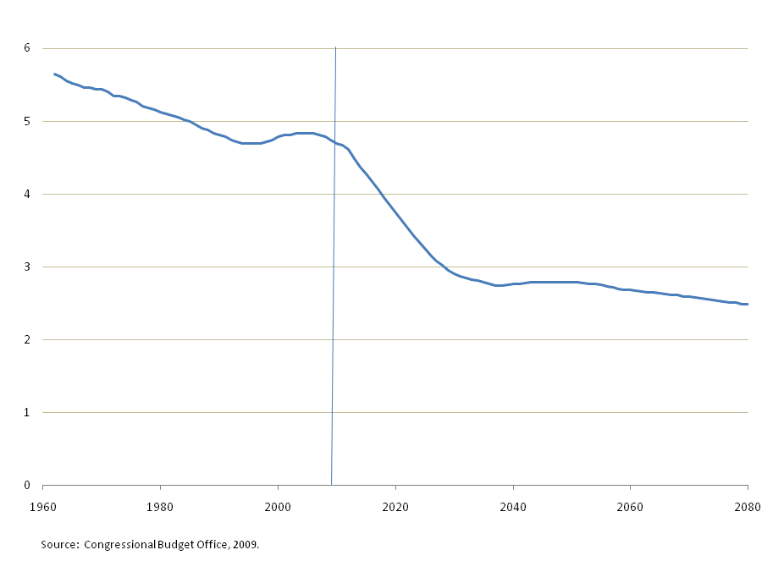
Ratio of Workers to Retirees

Slide 28
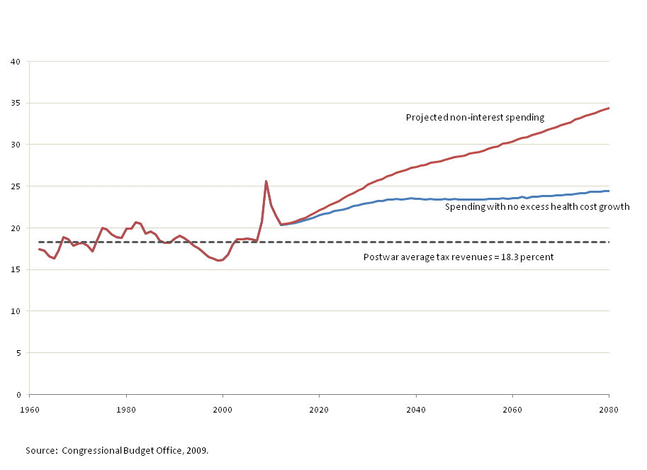
Primary Spending as % of GDP, with and without Excess Health Costs, 2062-2080

Slide 30
Federal+State+Local
Federal

Slide 31
Taxes
Tax revenues in US are low by international standards
We don’t have a VAT
Our corporate tax rate is high
Our income tax is full of subsidies and loopholes (“tax expenditures”)
And it’s complicated, unfair, and doesn’t raise enough revenue to pay for government
Economic inequality is at the highest level since the Great Depression

Slide 33
Consumption Tax as Percent of GDP, OECD Countries, 2007

Slide 34
Combined Federal, State, and Local Corporate Tax Rate in OECD Countries, 2011

Slide 35
Value and Number of Tax Expenditures

Slide 36
Tax Expenditures Compared to Other Spending, FY 2011
 | Income Tax Expenditure | Mandatory | Discretionary | Defense | Non-defense
$ Billions | 1,177 | 2,165 | 1,415 | 744 | 671
Percent | 24.7 | 45.5 | 29.7 | 15.6 | 14.1
% of GDP | 7.6 | 14.0 | 9.1 | 4.8 | 4.3
Tax expenditures are not chump change!

Slide 37
Tax Expenditures Compared to Other Taxes, FY 2011
 | Income Tax Expenditures | Net Individual Income Tax | Corporate Income Tax | Payroll Tax | Other
$ Billions | 1,177 | 1,121 | 297 | 935 | 214
Percent | 31.4 | 29.9 | 7.9 | 25.0 | 5.7
% of GDP | 7.6 | 7.2 | 1.9 | 6.0 | 1.4

Slide 40
Median Earnings for Full-Time, Full-Year Workers, in 2009$ 1974-2009

Slide 41
Highest Individual Income Tax Bracket, in percent, 1913-2011

